Slide 1
Drowsiness Detection System
Presented by
C Sankeerth Manmadhan (MCA23-126)
Guided by
Dr.Fousia M Shamsudeen

Slide 2


Introduction
A Drowsiness Detection System is a technology designed to monitor a person's alertness, typically by tracking their eye movements, to detect signs of sleepiness. The system mainly focus on users like late night studying students and work from home employes, where it can sound an alarm or trigger alerts when the individual shows signs of drowsiness.

Slide 3
Related Works
Driver drowsiness detection system, Sachin Kumar * , Priya Devi, Meghna Singh and Meetu Rani , IJSRA, 2024
Real-Time Face Detection Using a Moving Camera, Deng-Yuan Huang; Chao-Ho Chen; Tsong-Yi Chen; Jian-He Wu; Chien-Chuan Ko, IEEE,2022

Slide 4
Gap identified
Existing drowsiness detection systems are costly and unsuitable for personal desktop use.
This project offers an affordable, software-based solution using a laptop camera to provide real-time alerts for focus and wellness.

Slide 5
Problem Statement
A Drowsiness detection system using computer vision that automatically alerts user when drowsiness in detected.

Slide 6
Objective
To develop a lightweight drowsiness detection model using dlib to monitor signs without specialized hardware.
To ensure the system provides real-time feedback on drowsiness indicators.
To promote wellness and productivity by alerting users to take breaks when needed.
To create a user-friendly interface and validate accuracy through testing and user feedback.

Slide 7
Methodology
Input
(Webcam Feed)
Drowsiness Detection Algorithm
Drowsy
Pre-processing
Alert
Facial Landmark Detection (dlib)

Slide 8
Modules:
Input Module
Captures real-time video from webcam for continuous monitoring.
Preprocessing Module
Adjusts lighting and quality in frames for improved detection accuracy.
Feature Extraction Module
Uses Dlib’s facial landmark detection to find eye and mouth regions, essential for drowsiness detection.

Slide 9
Drowsiness & Yawn Detection Module
Eye Aspect Ratio (EAR): Measures eye closure duration for signs of drowsiness.
Mouth Aspect Ratio (MAR): Detects yawning by monitoring mouth movements.
Alert System Module
Triggers visual/auditory alerts if drowsiness indicators (eye closure, yawning) exceed set limits.

Slide 10
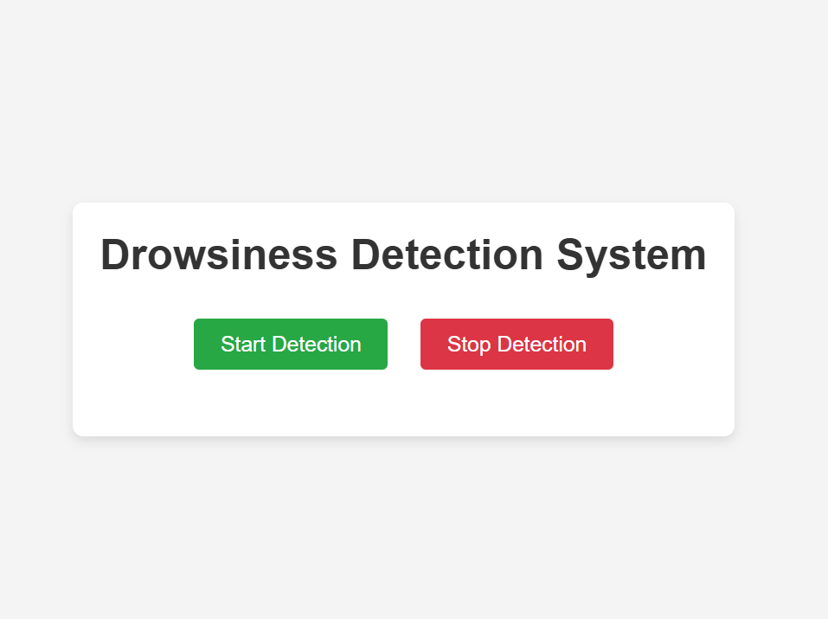
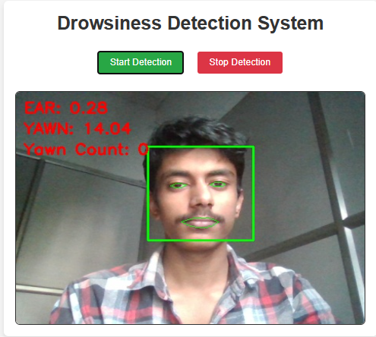
Results
Web interface
Face detection

Slide 11
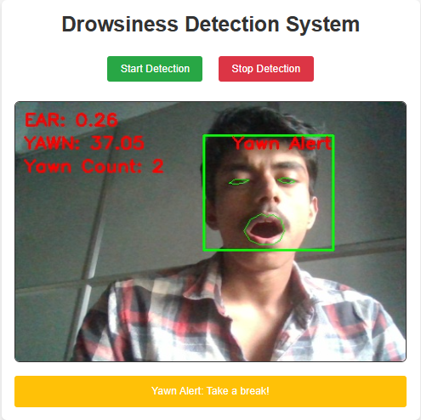
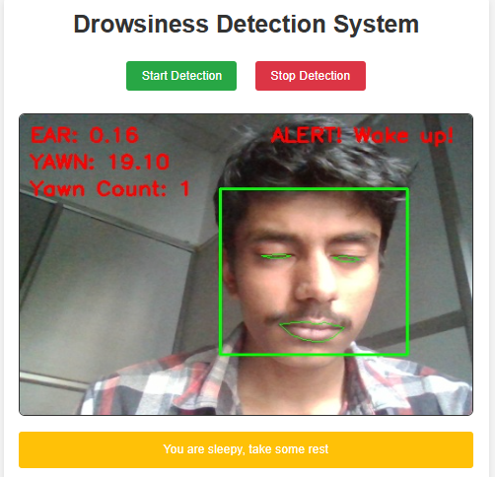
Drowsiness detection and alert
-
Yawn count and alert

Slide 12
Future enhancement
Advanced Machine Learning Models: Use CNNs or pre-trained models like OpenFace and Mediapipe for more accurate detection of eye closure, yawning, and head nodding.
Customizable Alerts: Enable personalized alert settings and break reminders to reduce fatigue and eye strain.
Low-Light Detection: Incorporate infrared-based models or adjust brightness and contrast in preprocessing to enhance drowsiness detection in dim lighting.

Slide 13
Conclusion
In conclusion, the Drowsiness Detection System effectively identifies signs of drowsiness and yawning, providing timely alerts to help late-night students and remote workers maintain focus and prevent fatigue-related lapses in productivity.

Slide 14
References
Rateb Jabbar, et al. (2018). Real-time Driver Drowsiness Detection for Android Using Deep Neural Networks. Procedia Computer Science, 130, 400-407. DOI link
T. Vesselenyi, et al. (2017). IOP Conf. Ser.: Mater. Sci. Eng., 252, 012097.
Driver Drowsiness Detection and Alert System using Python and OpenCV. ResearchGate. Link
Drowsy Driving Statistics. The Zebra. Link

Slide 15
Thank you

